Slide 1
20XD24 - OBJECT ORIENTED PROGRAMMING

Slide 2
Outline
Text and Reference Books
History of C++
Input and Output in C++

Slide 3
Text and Reference Books
TEXT BOOKS
BjarneStroustrup, “The C++ Programming Language”, Pearson Education, 2014.
Stanley B. Lippman, JoseeLajoie and Barbara E. Moo, “The C++ Primer”, Addison Wesley,2013.
REFERENCES
Scott Meyers, “More Effective C++”, Addison Wesley, 2008.
Bjarne Stroustrup, “The Design and Evolution of C++”, Addison Wesley, 2005.
Stanley B Lippman, “Inside the C++ Object Model”, Addison Wesley, 1996.

Slide 4
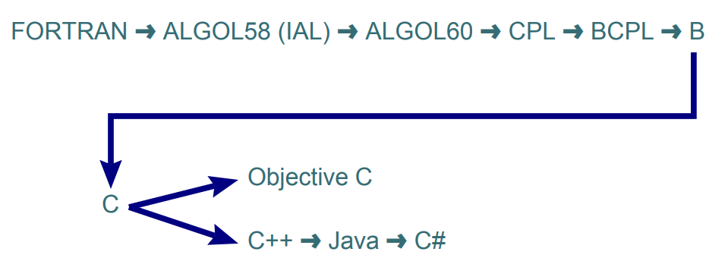
Computer Languages
The Lineage

Slide 5

Brief History of C++
C++ is an extension of C, developed by
Bjarne Stroustrup at Bell Laboratories
C++ is derived from the C language. Strictly
speaking, it is a superset of C
C++ was originally called “C with classes”, but later
it was renamed C++ in 1983
The most important elements added to C to
create C++ concern classes, objects, and
object-oriented programming
Object-oriented programming can make programs easy to reuse and easy to maintain
The features of C are supported by C++. C programs can be compiled using C++ compilers
Bjarne Stroustrup

Slide 6
Brief History of C++
An international standard for C++, known as C++98, was created by the International Standard Organization (ISO) in 1998
The ISO standard is an attempt to ensure that C++ is portable
A new standard, known as C++11, was approved by ISO in 2011. C++11 added new features into the core language and standard library
C++ is a general-purpose object-oriented programming language - means you can use C++ to write code for any programming task

Slide 7
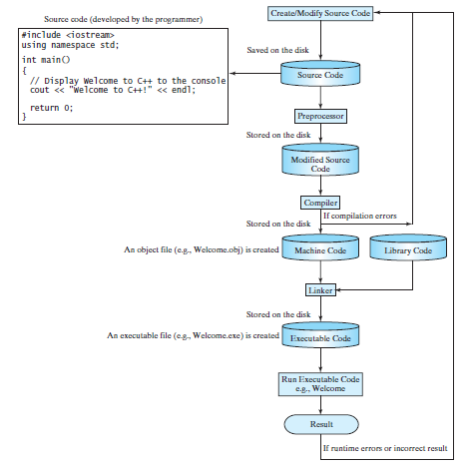
C++ Program Development Cycle

Slide 8
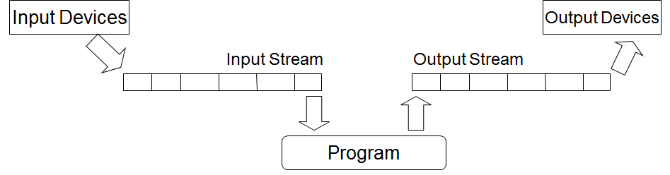
Streams in C++
C/C++ IO are based on streams, which are sequence of bytes flowing in and out of the programs
In input operations, data bytes flow from an input source (such as keyboard, file, network or another program) into the program
In output operations, data bytes flow from the program to an output sink (such as console, file, network or another program)
Streams - act as an intermediaries between the programs and the actual IO devices, in such the way that frees the programmers from handling the actual devices, so as to archive device independent IO operations

Slide 9
Input and Output in C++
In C++, iostream.h is used instead of stdio.h
Why this change?
Input/output routines in iostream can be extended to new types declared by the user
The C++ library contains several stream objects through which it can perform console I/O operations
I/O objects - represent data as streams or sequences of bytes (i.e., characters) as they enter or leave the running program
Three of the most common stream objects
cin
cout
cerr

Slide 10

Input and Output in C++
cin is an instance of a class named istream
cout and cerr are instances of a class named ostream
All three instances or objects are stored in a library, which the linker searches while creating the final executable program
#include <iostream> //Including a header file provides access to the I/O stream objects
using namespace std;
………
cout << "hello world" << endl;
#include <iostream>
………
std::cout << "hello world" << std::endl;

Slide 11
Input and Output in C++
Operators
<< (inserter or output) operator and
>> (extractor or input) operator
These two operators work in conjunction with cout, cerr, and cin to write data out from or read data into a program
Example
cout << "Hello world" << endl; // data output
cin >> counter; // data input
Note:
<< inserts data into the output stream while >> extracts data from the input stream
Think of the arrows as pointing in the direction that the data is flowing in relation to the I/O objects and the program

Slide 12
Why >> and << for I/O in C++?
Assignment operator = a candidate !
Input operator different from output operator
cout=a=b means cout=(a=b)
How about < and > ?
<< and >> are asymmetric not commonly used
Precedence of << is low
#include<iostream>
using namespace std;
int main()
{
int a=1,b=2,c=3;
cout<<“a*b+c=“<< a*b+c<<‘\n’;
}
Output
5

Slide 13
Why >> and << for I/O in C++?
Parentheses must be used when operator of lower precedence available
#include<iostream>
using namespace std;
int main()
{
int a=1,b=2,c=3;
cout<<“a^b/c =“<<(a^b/c)<<‘\n’;
}
Output
1

Slide 14
Why >> and << for I/O in C++?
Left shift operator << can be used in an output statement but it must appear within parentheses
#include<iostream>
using namespace std;
int main()
{
int a=1,b=2;
cout<<“a<<b=“<<(a<<b)<<‘\n’;
}
Output
4

Slide 15
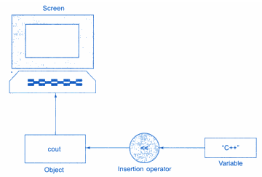
The Insertion Operator <<
cout - a predefined object that represents the standard output streams in C++
The operator used is known as the insertion or put-to operation as is represented as <<.
It sends the contents of a variable on its right to the object on its left
Syntax : cout<<variable; (or)
cout<<variable1<<variable2<< …<<variablen;

Slide 16
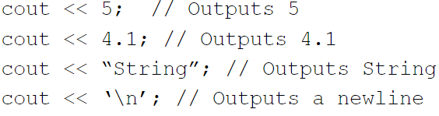
The Insertion Operator <<
Examples
Cascading or chaining of Output Operators
cout << “Sum=” << sum << “\n”;
cout << “Average=” << average << “\n”;
cout << A << B << C << D;
This is evaluated from left to right
(((cout << A) << B) << C) << D;

Slide 17
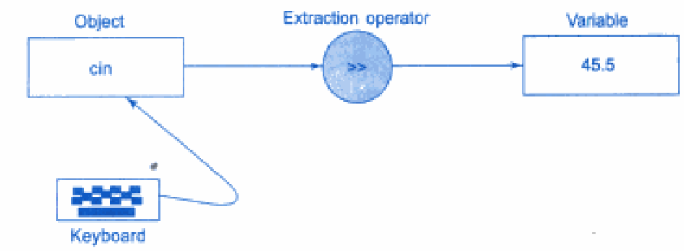
The Extraction Operator >>
cin - is a predefined object in C++ that corresponds to the standard input stream
Extraction or get-from operator is used and is represented as ‘>>’
It takes the value from the keyboard and assigns it to the variable on its right
Syntax : cin>>variable; (or) cin>>variable1>>…>>varaiblen;

Slide 18
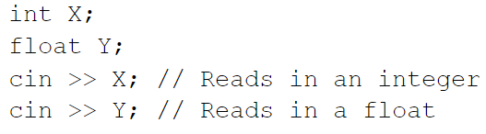
The Extraction Operator >>
Examples
Cascading or chaining of Input Operators
float a, b;
int c, d;
cin>>a>>b>>c>>d;

Slide 19
Advantages of Streams
Advantages of using the stream classes for I/O, instead of traditional C functions such as printf() and scanf(), and for files—fprintf(), fscanf(), and so on
Simplicity
There are no such formatting characters in streams, since each object already knows how to display - This removes a major source of errors
Overload existing operators and functions, such as the insertion (<<) and extraction (>>) operators, to work with classes that you create
This makes your own classes work in the same way as the built-in types, which again makes programming easier

Slide 20
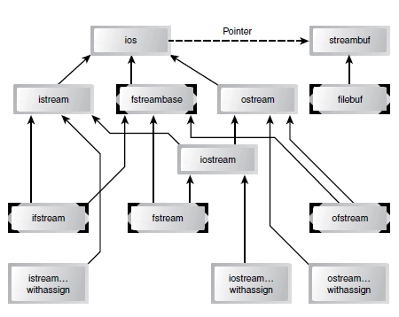

The Stream Class Hierarchy

Slide 21
The Stream Class Hierarchy
Extraction operator >> is a member of the istream class
Insertion operator << is a member of the ostream class
Both of these classes are derived from the ios class
The cout object - representing the standard output stream, which is usually directed to the video display, is a predefined object of the ostream_withassign class, which is derived from the ostream class
Similarly, cin is an object of the istream_withassign class, which is derived from istream
The classes used for input and output to the video display and keyboard are declared in the header file iostream

Slide 22
The Stream Class Hierarchy
ios class is the base class for the hierarchy
It contains many constants and member functions common to input and output operations of all kinds
Some of these, such as the showpoint and fixed formatting flags
The ios class also contains a pointer to the streambuf class, which contains the actual memory buffer into which data is read or written, and the low-level routines for handling this data
The streambuf class is referenced automatically by other classes

Slide 23
The Stream Class Hierarchy
The istream and ostream classes are derived from ios and are dedicated to input and output, respectively
The istream class contains such functions as get(), getline(), read(), and the overloaded extraction (>>) operators
The ostream class contains put() and write(), and the overloaded insertion (<<) operators
The iostream class is derived from both istream and ostream by multiple inheritance
References
http://osr507doc.xinuos.com/en/man/html.C%2B%2B/istream.C++.html
http://osr507doc.xinuos.com/en/man/html.C%2B%2B/ostream.C++.html
http://osr507doc.xinuos.com/en/man/html.C%2B%2B/ios.C++.html

Slide 24
The Stream Class Hierarchy
Three classes - istream_withassign, ostream_withassign, and iostream_withassign - are inherited from istream, ostream, and iostream, respectively
They add assignment operators to these classes
Formatted I/O operations
The three ways to display formatted input and output in C++ are:
ios class functions and flags
Manipulators
Member functions

Slide 25

Formatted Console I/O
There are several ways to set the formatting flags
Since they are members of the ios class, you must usually precede them with the name ios and the scope-resolution operator
For example, ios::skipws
All the flags can be set using the setf() and unsetf() ios member functions
#include <iostream>
#include <iomanip>
using namespace std;
int main()
{
char str[]="Hello";
cout.setf(ios::left);
cout<<setw(10)<<str<<setw(10)<<str<<endl;
cout.unsetf(ios::left);
cout<<setw(10)<<str<<setw(10)<<str<<endl;
cout.setf(ios::right);
cout<<setw(10)<<str<<setw(10)<<str<<endl;
return 0; }

Slide 26
Formatted Console I/O
The ios Class
Formatting Flags
The C++ input/output system uses bit-vectors, unsigned 32-bit integers, to control various aspects of how cin and cout behave
Each console object has a bit-vector that controls how output is formatted or how input is interpreted
Each bit in a bit-vector, called a flag, represents a specific formatting feature: a flag set to 1 indicates that a feature is switched on or is active, while a flag set to 0 indicates that the feature is switched off or is inactive
The I/O system also defines a pseudo data type, called fmtflags, to represent bit-vectors and bit-masks. Bit-masks are constant values that represent bit patterns, or, in this context, formatting flags
http://www.cplusplus.com/reference/ios/ios_base/fmtflags/

Slide 27
Manipulators
Manipulators are special functions that are designed to work with the inserter ( << ) and extractor ( >> ) operators in conjunction with one of the I/O stream objects
Note :
It is sufficient to #include <iostream> to use manipulators without arguments
You must also #include <iomanip> to use manipulators with arguments
A complete list of C++ manipulators
http://www.cplusplus.com/reference/library/manipulators/

Slide 28
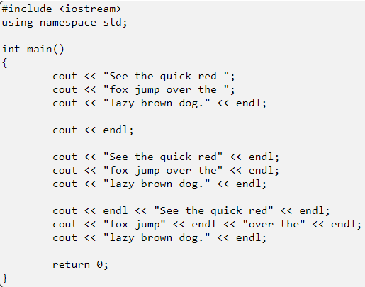
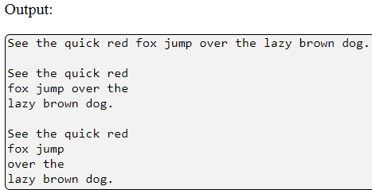
Manipulators
endl - Insert an end of line \n and flush the output buffer (the last character is a lower-case 'L')
Note : endl may appear anywhere, not just at the end of an output statement

Slide 29
Manipulators
dec - Displays output in decimal
hex - Displays output in hexadecimal
oct - Displays output in octal
Note:
The default output is decimal or base 10
Order is important: hex << number not number << hex
All three manipulators change one of the formatting flags; once changed, all numerical output will be in the new base until the base is changed by another manipulator or function

Slide 30
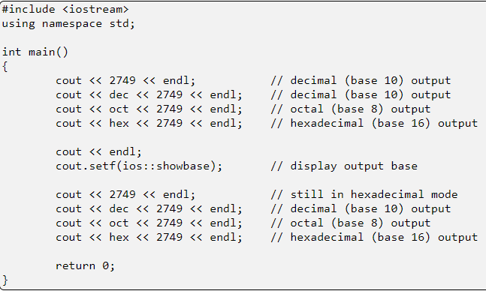

Manipulators

Slide 31
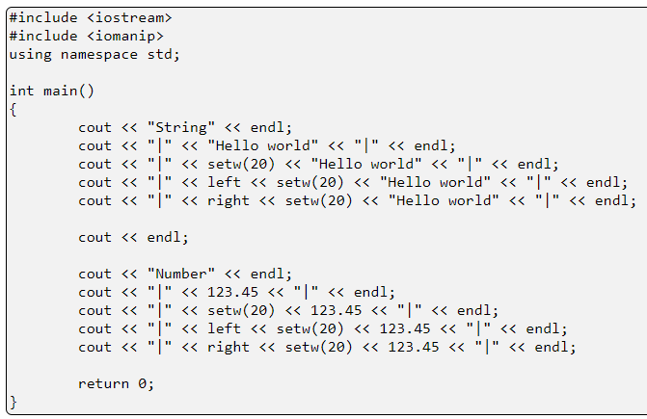
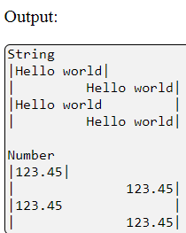
Manipulators
right - Right-align, pad on the left (used with setw )
left - Left-align, pad on the right (used with setw)

Slide 32
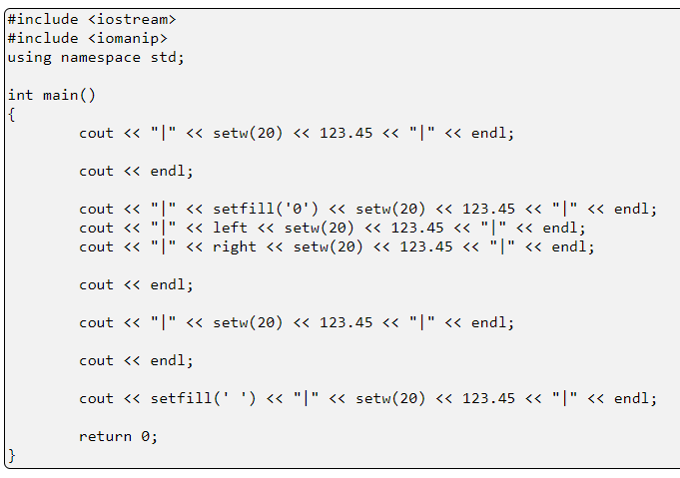
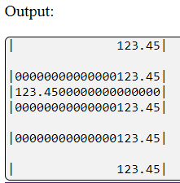
Manipulators

Slide 33
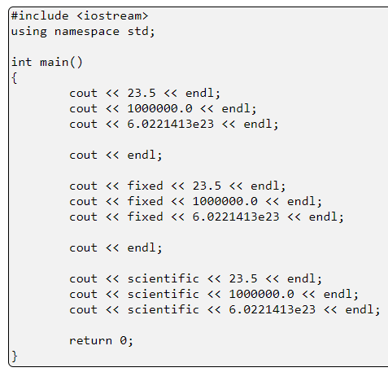
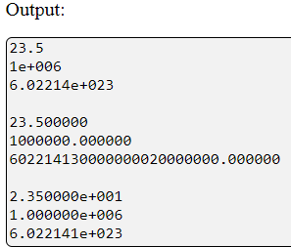
Manipulators
Fixed - Display numbers in a fixed decimal point notation (no scientific notation)
Scientific - Display numbers in scientific notation

Slide 34
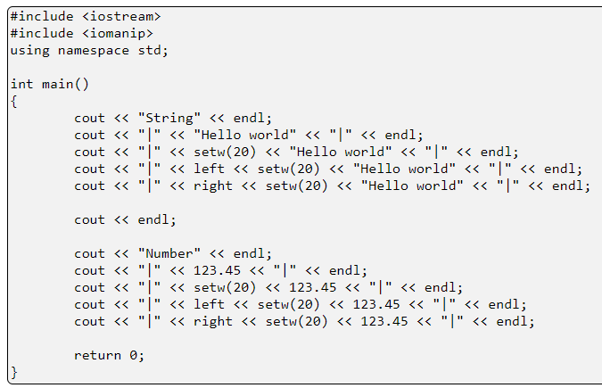
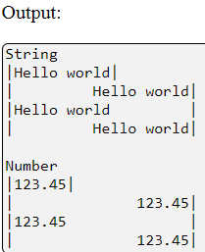
Manipulators
setw(int width) - Sets the output field width; if the output is shorter than the field with, the unused space is padded; the default pad character is a space but can be changed with "setfill"

Slide 35
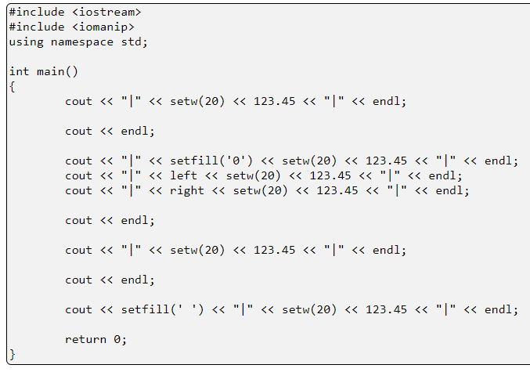
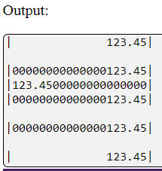
Manipulators
setfill(char fill) - Sets the padding or fill character when the output field is wider the printed data. The default fill character is a space or blank. Used with setw. Requires #include <iomanip>

Slide 36
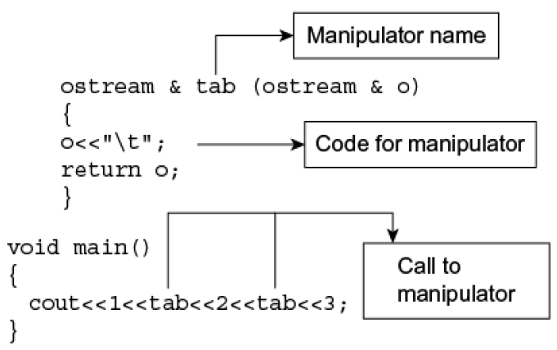
User-Defined Manipulators

Slide 37
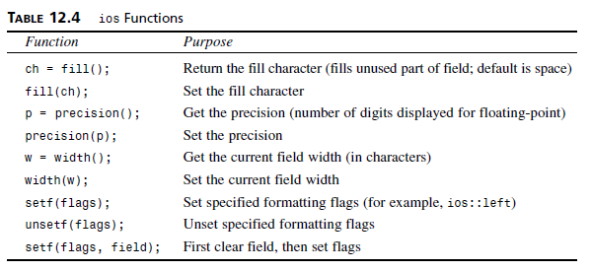
Member Functions
cout is an instance of a class named ostream
cin is an instance of istream
As instances, both objects may access any of the member functions belonging to each class
The ios class contains a number of functions that you can use to set the formatting flags and perform other tasks

Slide 38
Member Functions
These functions are called for specific stream objects using the normal dot operator
Examples
cout.width(14);
cout.fill(‘*’);
cout.setf(ios::left);
cout.unsetf(ios::left);
A two-argument version of setf() uses the second argument to reset all the flags of a particular type or field
Then the flag specified in the first argument is set. This makes it easier to reset the relevant flags before setting a new one

Slide 39
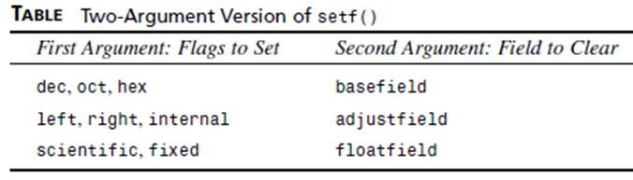
Member Functions
For example
cout.setf(ios::left, ios::adjustfield);
cout.setf(ios::scientific, ios::floatfield);
Clears all the flags dealing with text justification and then sets the left flag for left-justified output

Slide 40
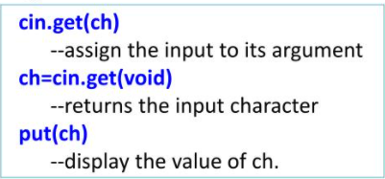

Unformatted I/O functions
put() and get() functions – member of ostream and istream respectively
Used to handle single character input and out operations
get() – takes two forms

Slide 41
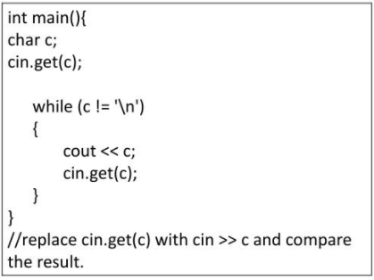
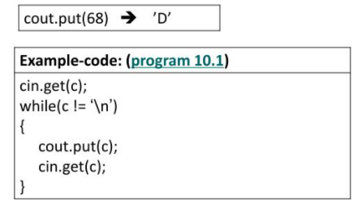
Unformatted I/O functions
Example

Slide 42
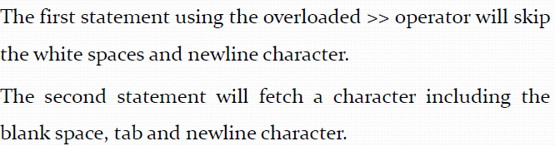
Unformatted I/O functions
How do the following two statements differ in operation?
cin>>ch;
cin.get(ch);

Slide 43
Reading Strings
A string can be read from the keyboard using the cin object.
https://web.stanford.edu/class/archive/cs/cs106b/cs106b.1132/handouts/08-C++-Strings.pdf
For example
string city;
cout << "Enter a city: ";
cin >> city; // Read to string city
cout << "You entered " << city << endl;
This approach to reading a string is simple, but there is a problem.
The input ends with a whitespace character. If you want to enter New York, you have to use an alternative approach

Slide 44
Reading Strings
C++ provides the getline function in the string header file, which reads a string from the keyboard
Syntax: getline(cin, s, delimitCharacter)
The function stops reading characters when the delimiter character is encountered.
The delimiter is read but not stored into the string. The third argument delimitCharacter has a default value ('\n')
string city;
cout << "Enter a city: ";
getline(cin, city, '\n'); // Same as getline(cin, city)
cout << "You entered " << city << endl;

Slide 45
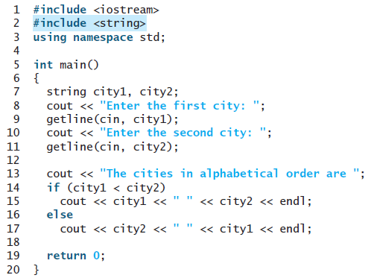

Reading Strings

Slide 46
Namespaces in C++
Namespace - a mechanism to avoid naming conflicts in a large program
As different pieces of a large application introduce new identifiers, it may happen that two different variables, functions or classes have the same name
The concept of namespaces was created in order to avoid this problem
The idea is that each identifier belongs to a certain namespace, and that different namespaces are kept separate so that they may contain equal identifiers

Slide 47
Namespaces in C++
A namespace defines a scope
using namespace std;
tells the compiler to use the standard namespace. std is an abbreviation of standard
Namespace is a mechanism to avoid naming conflicts in a large program
C++ uses namespaces to organize the names of program entities.
The statement using namespace std; declares that the program will be accessing entities whose names are part of the namespace called std (even namespaces have names!)
In order for a program to use the entities in iostream , it must have access to the std namespace

Slide 48
Namespaces in C++
Consider following C++ program
// A program to demonstrate need of namespace
int main()
{
int value;
value = 0;
double value; // Error here
value = 0.0;
}
Compiler Error:
'value' has a previous declaration as 'int value'
In each scope, a name can only represent one entity. So, there cannot be two variables with the same name in the same scope

Slide 49
Namespaces in C++
Defining a Namespace
A namespace definition begins with the keyword namespace followed by the namespace name namespace namespace name {
// code declarations
}
Example
namespace price {
double sqrt(const double);
}
To call the namespace-enabled version of either function or variable, prepend (::) the namespace name as follows
name::code; // code could be variable or function

Slide 50

Namespaces in C++
namespace price {
double sqrt(const double);
}

Slide 51
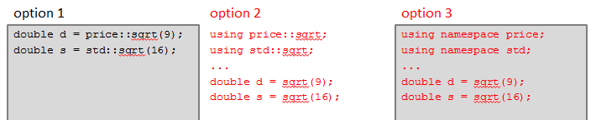
Preventing Conflicts
namespace price
{
double sqrt(const double);
}

Slide 52
Namespaces in C++
Using namespaces, we can create two variables or member functions having the same name
#include <iostream>
using namespace std;
namespace first
{
int val = 500;
}
// Global variable
int val = 100;
int main()
{
// Local variable
int val = 200;
// These variables can be accessed from outside the namespace using the scope operator ::
cout << first::val << '\n';
cout<<val;
cout<< ::val;
return 0;
}
Output:
500
200
100

Slide 53
Namespaces in C++
#include <iostream>
using namespace std;
// first name space
namespace first_space {
void func() {
cout << "Inside first_space\n" ;
}
}
// second name space
namespace second_space {
void func() {
cout << "Inside second_space\n" ;
}
}
int main () {
// Calls function from first name space.
first_space::func();
// Calls function from second name space.
second_space::func();
return 0;
}
Output
Inside first_space
Inside second_space

Slide 54
The using directive
This directive tells the compiler that the subsequent code is making use of names in the specified namespace
#include <iostream>
using namespace std;
// first name space
namespace first_space {
void func() {
cout << "Inside first_space" << endl;
}
}
// second name space
namespace second_space {
void func() {
cout << "Inside second_space" << endl;
}
}
using namespace first_space;
int main () {
// This calls function from first name space.
func();
return 0;
}
Output
Inside first_space

Slide 55
Namespaces in C++
Namespace declarations can be nested within another namespace
using namespace first_space::second_space;
int main () {
// This calls function from second name space.
func();
return 0;
}
#include <iostream>
using namespace std;
// first name space
namespace first_space {
void func() {
cout << "Inside first_space" << endl;
}
// second name space
namespace second_space {
void func() {
cout << "Inside second_space" << endl;
}
}
}
Output
Inside second_space

Slide 56
Namespaces in C++
// Creating namespaces
#include <iostream>
using namespace std;
namespace ns1
{
int value() { return 5; }
}
namespace ns2
{
const double x = 100;
double value() { return 2*x; }
}
int main()
{
// Access value function within ns1
cout << ns1::value() << '\n';
// Access value function within ns2
cout << ns2::value() << '\n';
// Access variable x directly
cout << ns2::x << '\n';
return 0;
}
Output:
5
200
100

Slide 57
Namespaces in C++
// A C++ program to demonstrate use of class in a namespace
#include <iostream>
using namespace std;
namespace ns
{
// A Class in a namespace
class geek
{
public:
void display()
{
cout << "ns::geek::display()\n";
}
};
}
int main()
{
// Creating Object of geek Class
ns::geek obj;
obj.display();
return 0;
}
Output:
ns::geek::display()

Slide 58
Namespaces in C++
A namespace is a declarative region that provides a scope to the identifiers (names of the types, function, variables etc) inside it
Multiple namespace blocks with the same name are allowed
Namespace declarations appear only at global scope
Namespace declarations can be nested within another namespace
Namespace declarations don’t have access specifiers (public or private)
No need to give semicolon after the closing brace of definition of namespace

